Slide 1
Deepening understanding with fractions of a given amount
Task A: Bar models to find the original amount
1) Match each problem to the correct bar model and solve.
a) Izzy is saving for a new camera. She has saved £42, which is two-fifths of the cost. How much does the camera cost?
b) A packet of crisps contains two-fifths extra free; it weighs 42 grams. How heavy is the normal packet?
c) Alex buys a sweatshirt in a sale saving you two-fifths. It cost him £42. How much was it before the sale?
b)
42
6
30 g
a)
42
21
£105
c)
42
14
£70

Slide 2
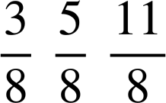
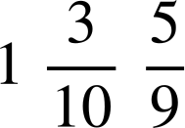


Deepening understanding with fractions of a given amount
Task B: Using double number lines
1) Match each problem to its double number line and solve.
a) The price of a camera increases by three-eighths to £165. How much did it cost before the increase?
b) Alex takes part in a spelling competition. He gets 165 right. This is three-eighths of the questions. How many questions were in the competition?
c) A multi-buy offer gives a discount of three-eighths. If you pay £165, how much is it without the discount?
b)
1
a)
1
Fraction
Fraction
Amount
Amount
165
440 questions
£120
165
c)
1
Fraction
Amount
165
£264
Task C: Finding the original amount using division
1) Jun gives £195 of his sponsorship money to his favourite charity; this is three-quarters of the total. How much money did Jun raise in total?
£260
2) A shop has a sale saving you one-third. Laura buys a t-shirt for £28. How much was it at full price?
£42
3) Alex improves his score on a computer game by two-sevenths. His improved score is 3204. What was his previous score?
2492
4) of 60 = of 140.4
5) of 33x = of 8x
What number is the square covering?
What term is the square covering?
Mathematics in Education and Industry
‹#›
v2.3

